Slide 1
Powder Metallurgy

Slide 2
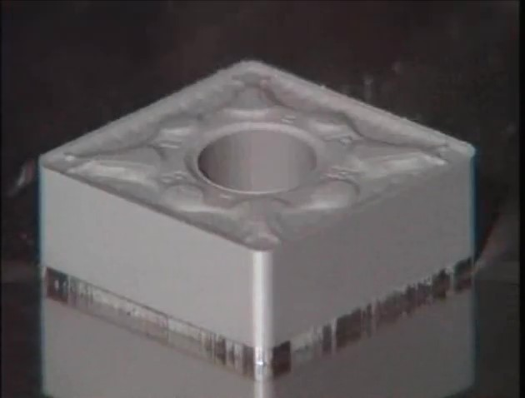
Watch Video Here
Notes:
PM Advantage

Slide 3
Powder Metallurgy in Cars
21 lbs in 1990
30 lbs in 1995
36 lbs in 2000
45 lbs in 2005
32 lbs in 2008 Cadillac V-6 engines
15 – 25 lbs in automatic transmissions

Slide 4
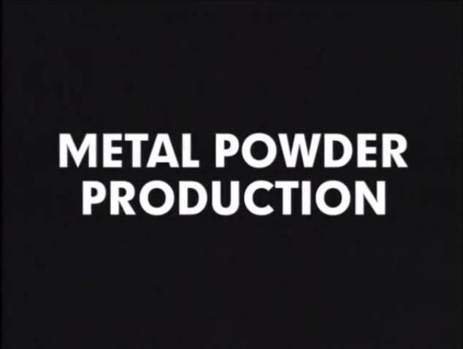
Watch Video Here
Notes:
Metal Powder Production

Slide 5
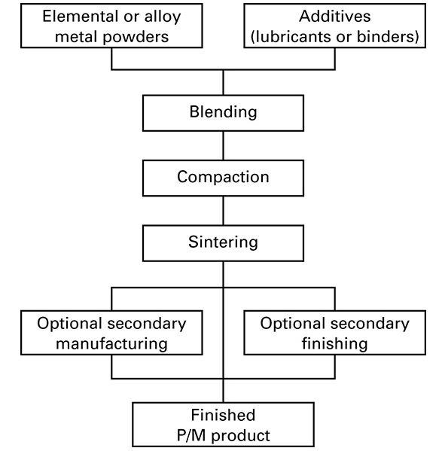
Basic Powder Metallurgy Process

Slide 6
Powder manufacture
Important variables:
particle size
size distribution
shape
surface texture

Slide 7
Significance of these four characteristics
Affect density
Enhance compaction

Slide 8
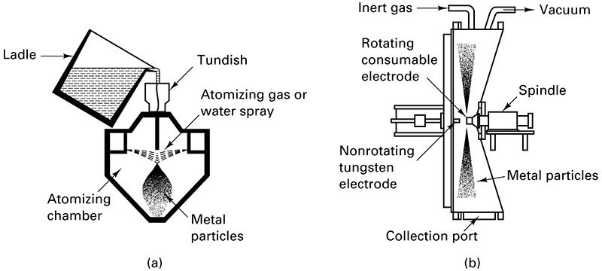
Melt Atomization

Slide 9
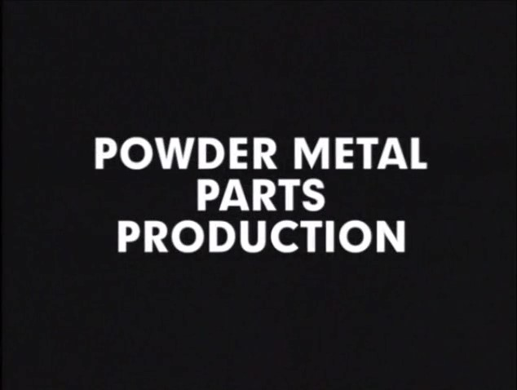
Watch Video Here
Notes:
Metal Parts Production

Slide 10
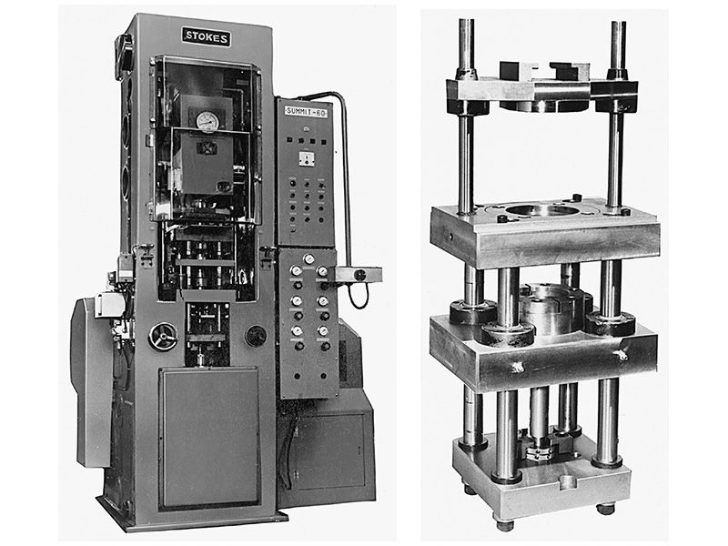
Press for compacting metal powders

Slide 11
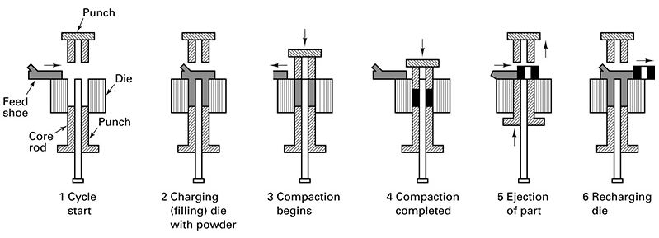
Compaction sequence

Slide 12
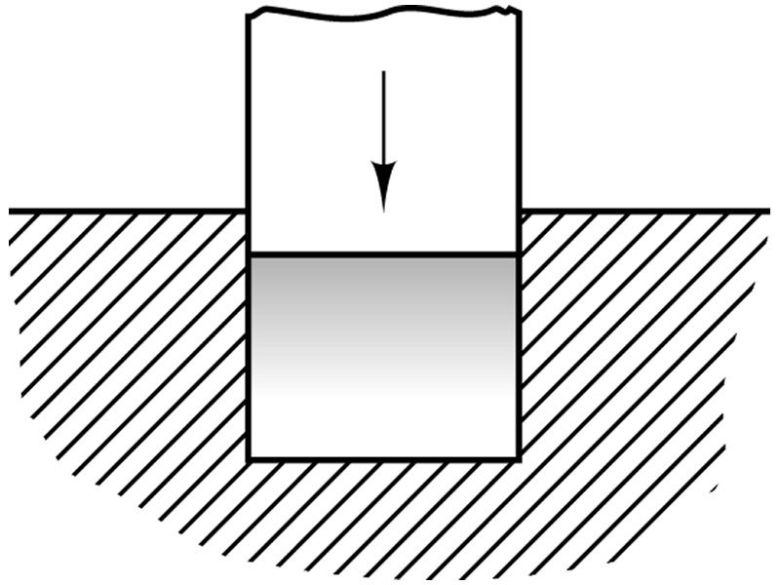
Single-punch compaction

Slide 13
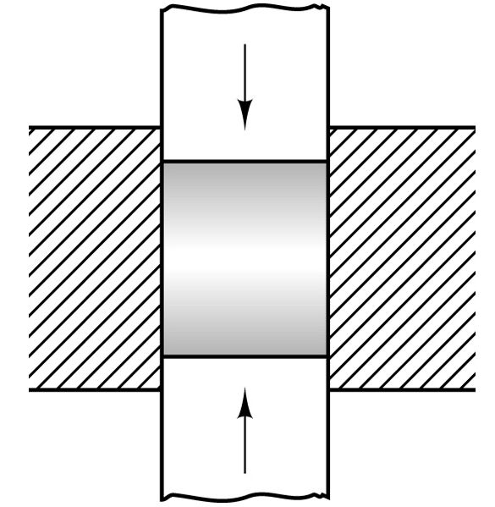
Double-punch compaction

Slide 14
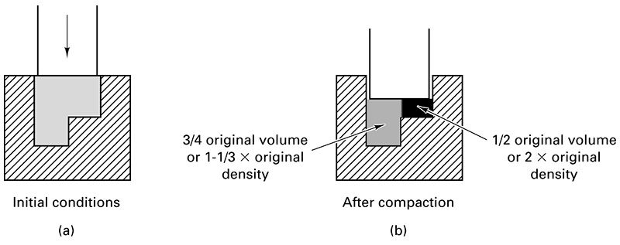
Non-uniform compaction

Slide 15
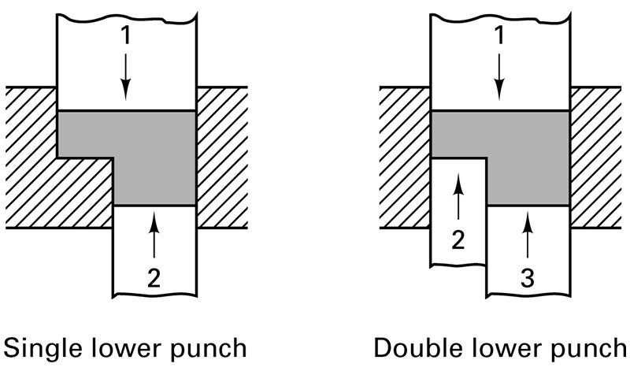
Uniform compaction

Slide 16
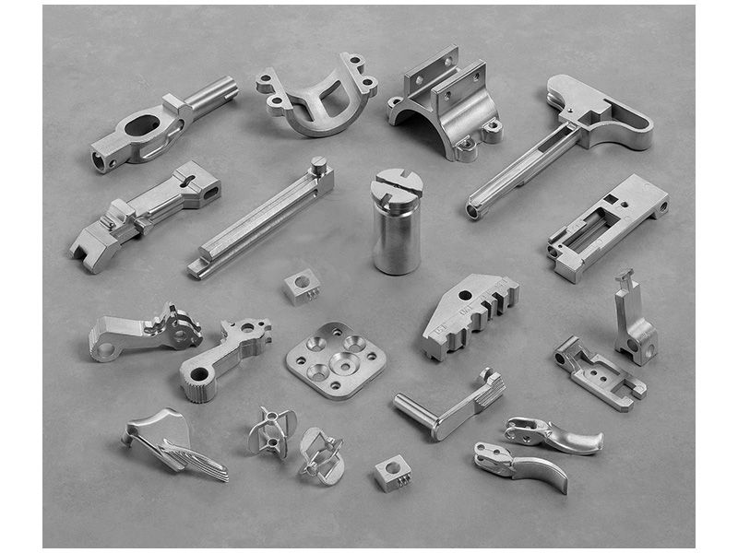
Metal Injection/Powder Injection Parts

Slide 17
High Quality Parts from MIM/PIM Processes
High final density – 95-99% of wrought
Uniform density
Close tolerances (0.3-0.5%)
Excellent surface finish

Slide 18
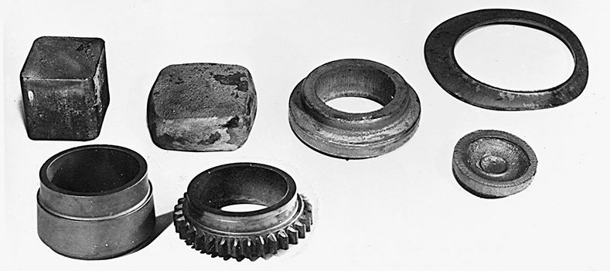
Conventional vs. PM Mfg. Gear Blanks

Slide 19
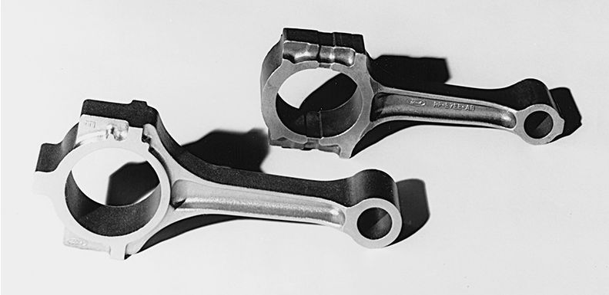
PM Preform and connecting rod

Slide 20
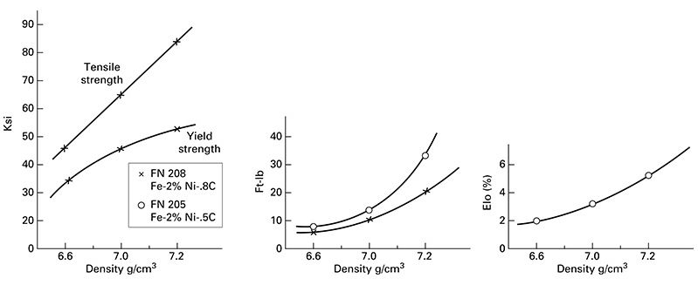
Mechanical Properties PM Parts

Slide 21
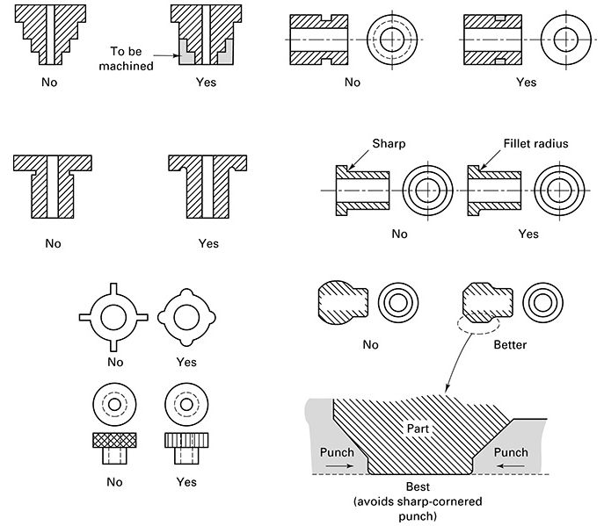
Poor and Good PM Design Features

Slide 22
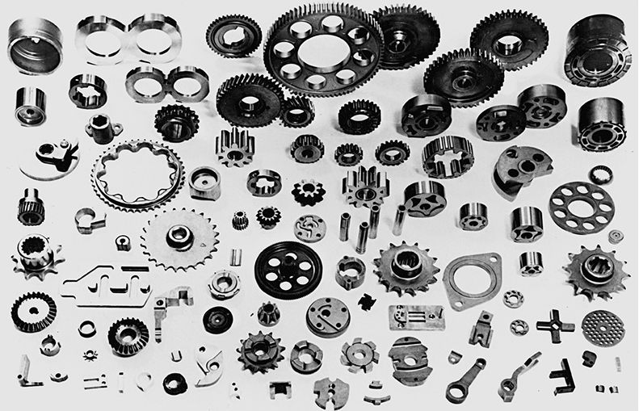
Typical PM Parts

